Slide 1
Week 2 (2) – Fundamental Data Structures
CST370 – Design & Analysis of Algorithms
Dr. Byun
Computer Science

Slide 2
Lecture Objectives
After completion of this lecture, you will be able to
  recall the important linear data structures such as the array and linked list.
  explain the basic terminologies of a graph and represent it using two different representations.

Slide 3
Chapter 1: Introduction
1.1 What is an Algorithm?
1.2 Fundamentals of Algorithmic Problem Solving
1.3 Important Problem Types
1.4 Fundamental Data Structures

Slide 4
<<< Course Instruction >>>
Before going on to the next slide, read pages 25 – 28 (just before “Graphs”) of the textbook.
  In this section, you will review the basic linear data structures such as arrays, linked lists (singly linked list and doubly linked list), stacks, and queues.
  Because you already took a data structures course before, this topic will be straightforward.

Slide 5
Introduction to Graphs
A graph is composed of nodes (= vertices) and lines (= edges).
  They are used for modeling many real-life applications such as transportation, communication networks, project scheduling, etc.
Example
SEA
CHI
SFO
JFK
LAX

Slide 6
<<< Course Instruction >>>
Read pages 28 – 30 (just before “Weighted Graphs”) in the textbook before moving on to the next slide.
  Graphs are an important data structure in Computer Science.
  We will cover many different graph algorithms for the entire semester.

Slide 7
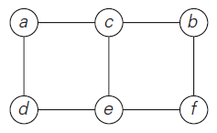
Graph Definition (1 of 2)
Formally, a graph G = <V,E> is defined by a pair of two sets: a finite nonempty set V of items called vertices and a set E of pairs of these items called edges.
Example: Undirected graph
  It has six vertices and seven undirected edges:
  V = {a, b, c, d, e, f }
  E = {(a, c), (a, d), (b, c), (b, f ), (c, e), (d, e), (e, f )}

Slide 8
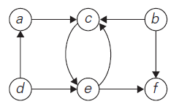
Graph Definition (2 of 2)
Example: Directed graph (or Digraph)
  It has six vertices and eight directed edges:
  V = {a, b, c, d, e, f }
  E = {(a, c), (b, c), (b, f ), (c, e), (d, a), (d, e), (e, c), (e, f )}

Slide 9
Question
Are the figure (i) and (ii) graphs?
a
a
b
c
b
c
(i)
(ii)

Slide 10
Answer
Both are graphs.
  Figure (i) has three vertices and two undirected edges:
  V = {a, b, c }
  E = {(a, b), (a, c)}
  Figure (ii) has three vertices and zero edges:
  V = {a, b, c }
  E = { }

Slide 11
Question
How about the figure (iii), (iv), and (v)?
  Are they graphs?
a
a
a
b
c
a
c
b
c
(iii)
(iv)
(v)

Slide 12
Answer
Figure (v) is a graph. But figure (iii) and (iv) are not graphs.
  Figure (iii) has duplicated edges:
  E = {(a, b), (a, b), (a, c)}
  Figure (iv) has duplicated vertices:
  V = {a, a, c }
  Since V and E are sets in the graph definition, they can’t have duplication.
  However, figure (v) is fine because the edge (a, b) and (b, a) indicate different edges in the directed graph.

Slide 13
<<< Course Instruction >>>
Conventionally, we enumerate a set’s elements using a non-decreasing order.
  For example, in the digraph on slide number 8, the sets V and E are shown as follows:
  V = {a, b, c, d, e, f }
  E = {(a, c), (b, c), (b, f ), (c, e), (d, a), (d, e), (e, c), (e, f )}
  When expressing these sets, the sequence is not important. However, we enumerate the elements in alphabetical order (from a to z) in this class.
  You must always follow this convention when you are doing homework or at exams.

Slide 14
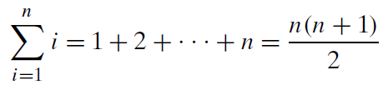
Useful Formula for the Analysis of Algorithms
You will use the following formula multiple times in the algorithm analysis.
Example
  1 + 2 + … + 100 = (100*101)/2 = 5050
You must memorize this formula as a CS major.
  Or you can understand this formula more easily with this video.
  https://www.youtube.com/watch?v=qrvcWgdkGi8

Slide 15
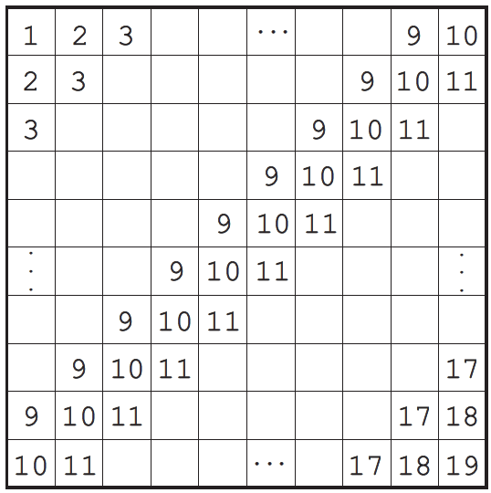
Puzzle: Add numbers in a table
A 10 × 10 table is filled with repeating numbers on its diagonals as shown below.
  Calculate the total sum of the table’s numbers.

Slide 16
Important Note
Do not see the answer immediately on the next page.
Hint
  It is not a good idea to add all the numbers one by one without a systematic approach.
  There are at least two different ways to calculate this sum efficiently.

Slide 17
Solution 1
You can compute the sum row by row (or column by column).
  The sum in the first row is equal to (10*11)/2 = 55.
  The sum of the numbers in second row is 55+10 since each of the numbers is larger by 1 than their counterparts in the row above.
  The same is true for all the other rows as well.
  Hence the total sum is equal to
  55+(55+10)+(55+20)+· · ·+ (55+90)
  = 55*10 + (10+20+· · ·+90)
  = 1000.

Slide 18
Solution 2
Another approach is based on the observation that the sum of any two numbers in the squares symmetric with respect to the diagonal connecting the lower left and upper right corners is equal to 20 such as “1 + 19”, “2 + 18”, “2 + 18”, and so on.
  Since there are (10*10 − 10)/2 = 45 such pairs (we subtracted the number of the squares on that diagonal from the total number of the squares), the sum of the numbers outside that diagonal is equal to 20*45 = 900. With 10*10 = 100 on the diagonal, the total sum is equal to 900 + 100 = 1000.

Slide 19

Remaining Topics in the Graph
Study the textbook to understand the following formula:
Also, understand the following terms:
  Complete graph
  Dense graph
  Sparse graph

Slide 20
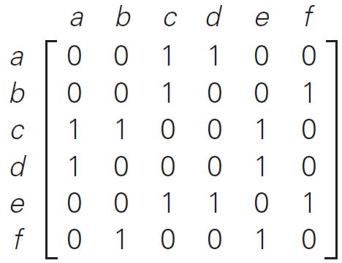
Graph Representations: Adjacency matrix
Example
Graph
Adjacency Matrix

Slide 21
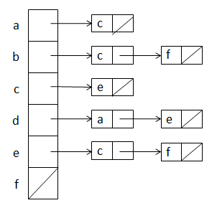
Graph Representations: Adjacency list
Example
Graph
Adjacency List

Slide 22
Exercise
Represent the following graph in adjacency matrix and adjacency list.
  Again, do not see the answer immediately. Try to solve it first.
a
b
c

Slide 23
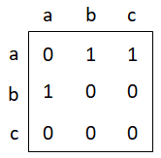
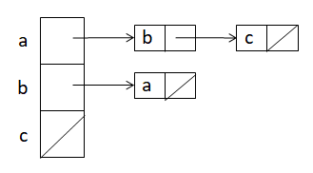
Solution
Adjacency Matrix
Adjacency List

Slide 24
<<< Course Instruction >>>
This lesson is over.
  If you do not understand any part in the lecture, study it again.
When you are done, study the next lecture (week_2_3.ppt) on iLearn.

